Slide 1
Introduction to Category Theory
Karel Stryczek

Slide 2
Outline
Examples of Collections of Mathematical Objects
Sets
Groups
Generalizing Collections to Categories
Introduction to Categories
Objects
Morphisms
Identity
Composition
Associativity
Unitality

Slide 3
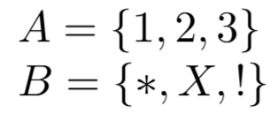
Sets and Set Functions
Sets can be basically described as collections of elements.
Example:

Slide 4
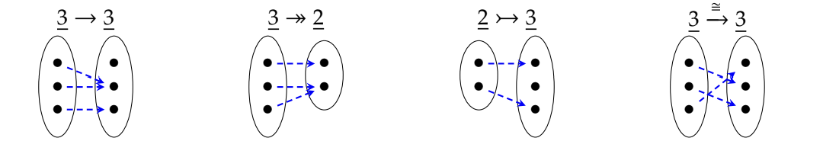
Sets and Set Functions cont.
A function is a relationship wherein each element in the domain maps to exactly one element in the range
Note: Every element in the domain is mapped

Slide 5
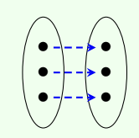

Sets and Set Functions: Identity
There are two additional properties to consider with sets and set functions, the first is identity.
Maps the element of a set to the same element in the same set
The element “is itself”
Identity Function:

Slide 6
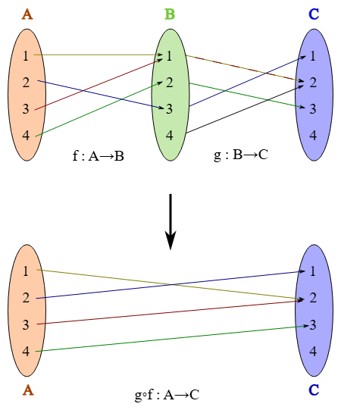
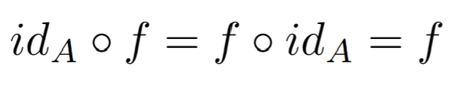

Sets and Set Functions: Composition
We can compose set functions, or in other words apply one function, then apply another.
Moreover, this is equivalent to a new function, built from these two!
Defined with Associativity, and for identity function, Unitality
Notes:
Add diagrams of composition

Slide 7

Groups and Group Homomorphisms
Groups have a set and binary operation which follow the closure, identity, associative, and inverse axioms; think of groups as a structured set.
Example:

Slide 8
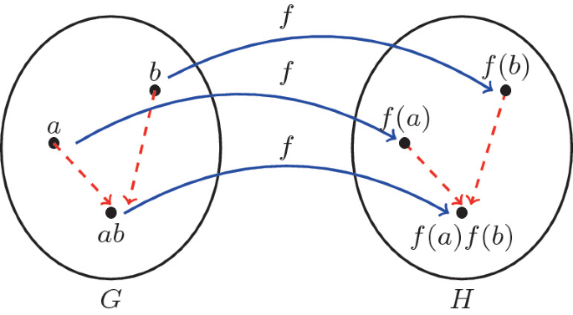
Groups and Group Homomorphisms cont.
Group Homomorphisms are specific functions between Groups that follow the below rule
f(ab)=f(a)f(b); where a,b are in G and f is a function from G to H
Consider where these operations occur

Slide 9


Groups and Group Homomorphisms: Identity
Identity is a group homomorphism, has to follow the rules previously described.
Drawn same way as an identity function.

Slide 10
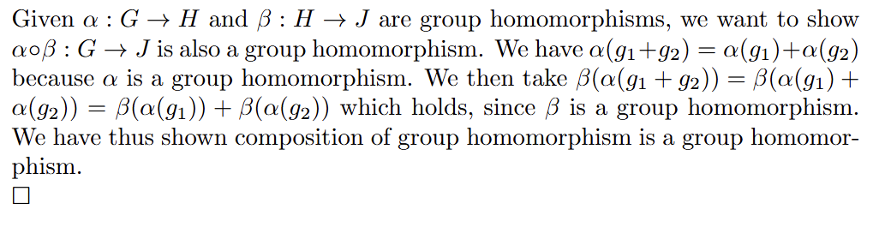
Groups and Group Homomorphisms: Composition
Similar to set functions, however we need to show the composition of group homomorphisms results in a group homomorphism.
Composition is defined the same as it is for set functions
One needs to check the Associativity and Unitality axioms for the way composition is defined (follows from set function composition)
Notes:
Add diagrams of composition

Slide 11
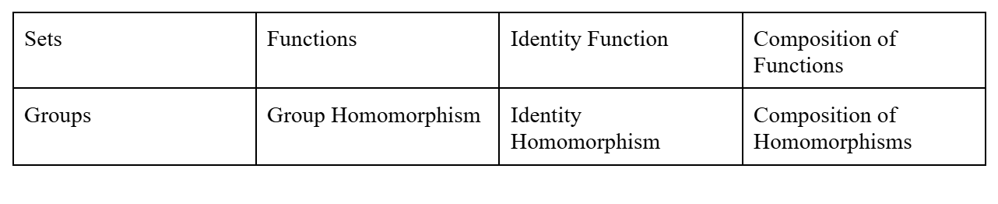
Our Two Examples Summarized
These morphisms follow the Associativity and Unitality Axioms

Slide 12
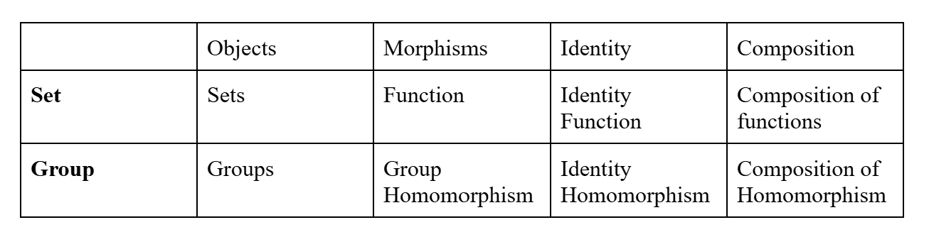
Comparison of Examples
A look at the similar properties of the examples (Group and Set)
These morphisms follow the Associativity and Unitality Axioms

Slide 13

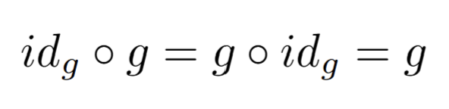
(Loose) Definition of Category
Common structure we’ve highlighted comes together to form categories
Categorically, Sets and Groups can be described using these terms
Objects: A category has a collection of these things called objects
Morphisms: Maps or arrows between objects
Composition: A rule which takes two morphisms and assigns another morphism
Identity: A particular morphism satisfying the Unitality axiom using the given composition
Composition must abide by the Associativity and Unitality Axioms
Associativity:
Unitality:

Slide 14
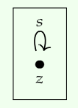
There are objects which themselves act as categories: Groups
Group is a groupoid with a single object
(Groupoid: category with only isomorphisms)
Not so much focus on the object, just look at morphisms

Slide 15


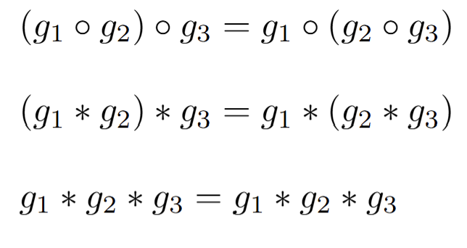
Checking the Properties of a Group as a One Object Category
We have our one object, and morphisms are the elements of our Group, and our identity morphism denoted:
Composition defined by the binary operation from the group:
Associativity:
Unitality:

Slide 16
In Conclusion
There is a way of picking out commonalities between mathematical objects and using a unified language to describe them all, this is a basic tenet of Category Theory
You can do this at a level of concrete collections, such as collections of sets and collections of groups, or more abstractly examples such as a group itself

Slide 17
Sources
https://en.m.wikipedia.org/wiki/File:Example_for_a_composition_of_two_functions.svg
https://link.springer.com/chapter/10.1007/978-981-16-6365-9_11
Fong, Brendan and Spivak, David. Seven Sketches in Compositionality: An Invitation to Applied Category Theory.

